Slide 1





Strategic Network Architecture Design for Global Banking
A Defense-in-Depth Approach to Multinational Financial Security
Presented by: Jeremiah Dighomanor
Developers Foundry Fellow 2.0 (Cybersecurity Track)
Notes:
1

Slide 2
Design Philosophy & Core Principles
Zero Trust Architecture
Defense in Depth
Never trust, always verify, even for internal traffic.
Implementing layered security controls (Firewalls, IPS, WAF, SIEM).
Least Privilege
Blast Radius Containment
Restricting access to the absolute minimum required for each role/system.
Using strict segmentation to prevent lateral movement during a breach.
Notes:
2

Slide 3

DMZ
Application Tier
Data Tier
Corporate &
Management
High-Level Segmentation (The Zone Model)
This diagram shows how different parts of the network are separated for security. The DMZ handles public-facing services like online banking and email gateways. The Application Tier is where the core business logic and transaction processing happens. The Data Tier protects the most valuable assets, like customer data and transaction records, with strong encryption. Finally, the Corporate & Management zone is for isolated employee workstations and special admin "Jump Servers" to manage everything securely.
Notes:
3

Slide 4
Technical Security Controls (The Guards)
Perimeter Security
Deep Packet Inspection & SSL Inspection
Palo Alto PA-5220 / Fortinet FortiGate
Web Protection
Mitigating SQLi, XSS, and DDoS
Cloudflare WAF / AWS WAF
Intrusion Defense
Real-time threat blocking (IPS)
Cisco Firepower / Suricata
Access Control
Device health & compliance checks
Cisco ISE / Aruba ClearPass
Notes:
4

Slide 5




Resilience & Availability
High Availability (HA)
Load Balancing
Active/Passive firewall failover to ensure zero downtime.
Layer 7 (Application Layer) intelligence to distribute traffic across healthy clusters.
DDoS Protection
Disaster Recovery
Cloud-based scrubbing to absorb massive traffic spikes before they hit the bank.
Encrypted backup storage isolated in the Data Tier.
Notes:
5

Slide 6
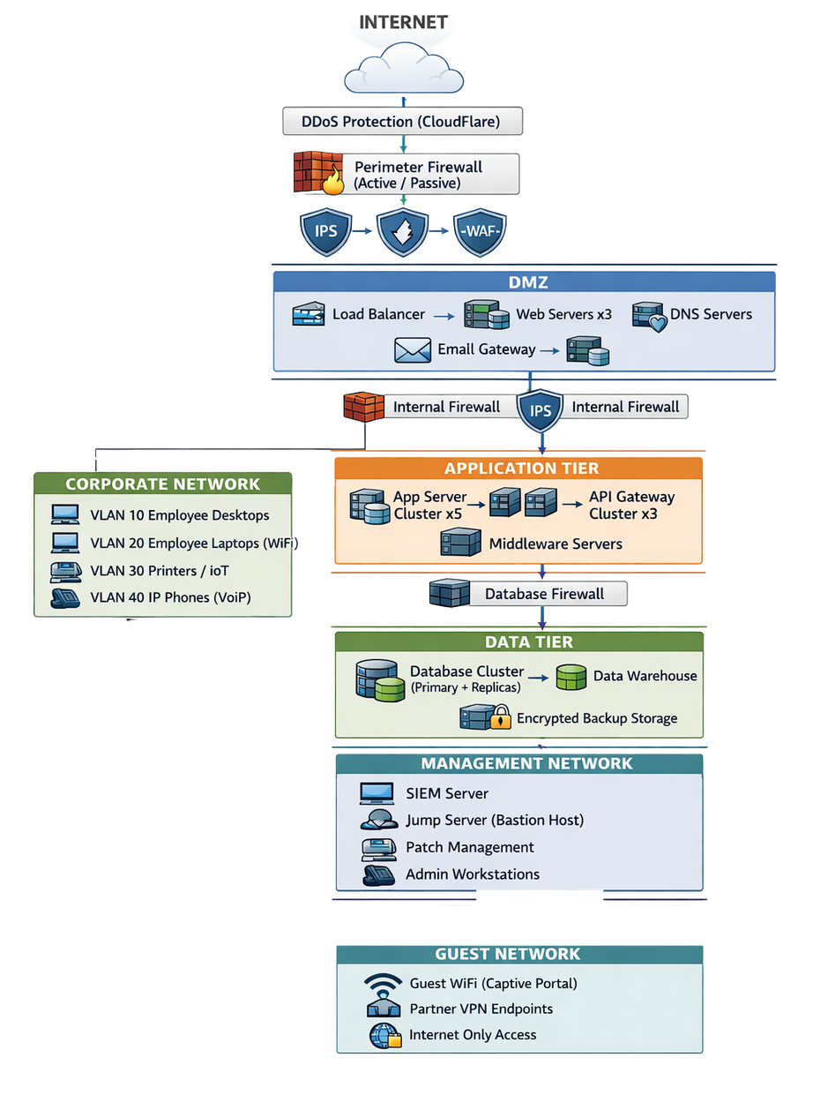
Network Security Architecture
Layered Security & Risk Reduction: Multiple security controls (DDoS protection, firewalls, IPS, WAF) enforce defense-in-depth and significantly reduce exposure to external and internal threats.
Strong Segmentation & Data Protection: Clear separation between DMZ, application, data, corporate, management, and guest networks limits attack spread and protects sensitive business data.
Resilient & Scalable Design: High-availability components, centralized monitoring, and isolated management access support operational continuity, compliance, and future growth.
Notes:
6

Slide 7

Monitoring & The Command Center
SIEM Integration: Centralized logging from all zones to correlate events (e.g., detecting brute force across multiple servers).
Privileged Access Management (PAM): MFA and session recording for all administrative actions.
VLAN Segmentation: Logically separating office devices (Printers vs. Laptops) to prevent local pivoting.
Notes:
7

Slide 8
Conclusion & Success Metrics
< 15
< 1
MTTD (Mean Time to Detect)
MTTR (Mean Time to Respond)
minutes
hour
Final Goal:
A scalable, compliance-ready architecture (PCI-DSS/GDPR) that protects the bank’s confidentiality, integrity, and availability.
Notes:
8

Slide 9

Thank You
for your attention and engagement.
Questions & Answers
Comments & Feedback
I appreciate you and look forward to your questions and feedback as we continue to strengthen our network security posture.
Notes:
9

